Slide 1
Building Geography Skills
Day 6

Slide 2
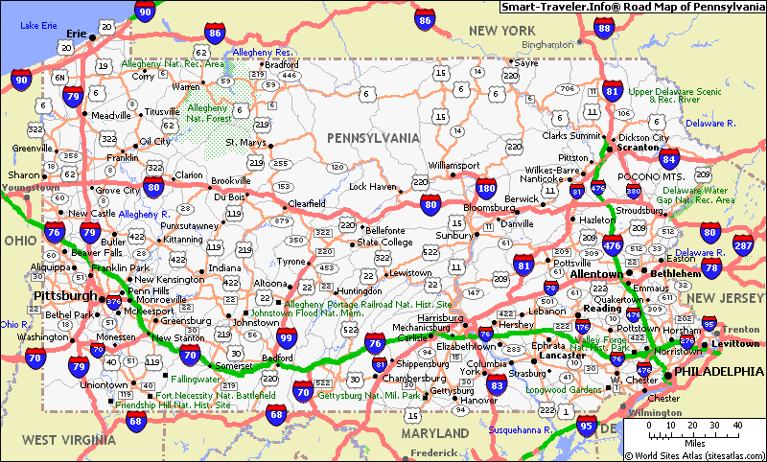
Think About a Time
Have you or your parents ever used a map or GPS (which is just an electronic map)? Where were you and what did you use the map or GPS for? Write three lines describing your experience.
Share with a partner.

Slide 3
Use the map on pg. H12 to help you complete the following activity.

Slide 4
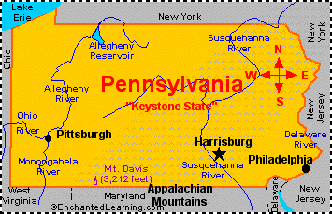
Which city on the map is located farthest west in Pennsylvania?
Erie
1.

Slide 5
Which city is located farthest southeast in Pennsylvania?
Philadelphia
2.

Slide 6
What does the large black circle on this map stand for?
A population of more than 1,490,000 people
3.

Slide 7
Use the map on pg. H13 to help you complete the following activity.

Slide 8
On the map, 50 miles is equal to what length?
About 1 inch
4.

Slide 9
What is the distance between Pittsburgh and Harrisburg?
About 150 miles
5.

Slide 10
What is the distance between Daniel Boone’s Homestead and Eckley Miner’s Village?
About 50
miles
6.

Slide 11
Question for You!
Write an explanation about why maps use different scales?
The scale depends on the size of the area shown.

Slide 12
Read about using a grid on pg. H14.
Then use the map and grid on pg. H14 to answer the following questions.

Slide 13
What building is located in grid B3?
U.S. Mint
7.

Slide 14
What square is located in grid C2?
Washington Square
8.

Slide 15
What grid is Carpenters’ Hall located in?
C3
9.

Slide 16
What two grids is Penn’s Landing located in?
C4 & D4
10.

Slide 17

Homework
Directions

Slide 19
Map Grid Activity
Activity A:
1. Erie
2. Raystown Lake
3. 1st Oil Well Drilled
4. Delaware Water Gap
5. Johnstown
6. Independence Hall
7. New Jersey
8. Pittsburgh
Activity B:
1. E-3
2. B-2 & C-2
3. F-3
4. D-3
5. B-4
6. F-2
7. D-2
8. E-2 or E-3

